Slide 1
Movie Review Checker
Rishik Karanjiya (18DIT023)

Slide 2
Introduction
This project will help you to get review about which movie you want to watch.
In this project we fetching data from IMDb offical website.
This project help you for movie suggestion based on IMDb ratings.

Slide 3
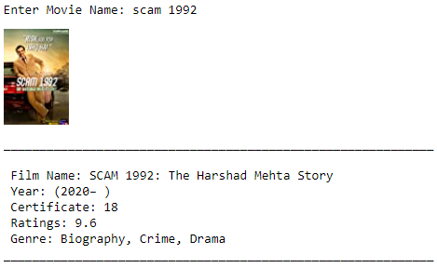
Implementation

Slide 4
Conclusion
In this project I have learn about How to using dependency in python file and how it is work and how to scrap data from particular website. Learn about different modules and their uses.

Slide 5
References
https://github.com/rkaranjiya/Movie-Review-Checker.git
https://www.imdb.com/
https://www.crummy.com/software/BeautifulSoup/bs4/doc/

Slide 6
THANK YOU

